Slide 1




Noida Institute of Engineering and Technology, Greater Noida
Behavioral Design Pattern - II
Unit: 5
Design Pattern(ACSE0514)
Behavioral Design Pattern - II
Renu Panwar
Assistant Professor
CSE(AIML)
Course Details (B Tech 5th Sem)

Slide 2
Faculty Introduction
Name | Renu Panwar
Qualification | M. Tech. (CSE),B.Tech (CSE)
Designation | Assistant Professor
Department | Computer Science & Engineering-AIML
Total Experience | 12 years
NIET Experience | 5.5 years
Subject Taught | Core Java and Advance Java, Artificial Intelligence, Soft Computing, C Programming, Web Technology,Operating System,OOPs ,C++,Machine Learning,Deep Learning.

Slide 3
Evaluation Scheme
Python Web development with Django (Elective I)
Design Pattern (Elective II)

Slide 4
Syllabus
UNIT-V: Behavioral Design Patterns Part: II
Behavioral Patterns Part: III, State, Strategy, Template Method, Visitor, What to Expect from Design Patterns. A case Study: Designing a document Editor.

Slide 5
Design Pattern Applications
1. Real-time web analytics
2. Digital Advertising
3. E-Commerce
4. Publishing
5. Massively Multiplayer Online Games
6. Backend Services and Messaging
7. Project Management & Collaboration
8. Real time Monitoring Services
9.Live Charting and Graphing
10. Group and Private Chat

Slide 6
Course Objective
In this semester, the students will
Study how to show relationships and interactions between classes or objects.
Study to speed up the development process by providing well-tested, proven development/design paradigms.
Select a specific design pattern for the solution of a given design problem.
Create a catalog entry for a simple design pattern whose purpose and application are understood.

Slide 7
Course Outcomes (COs)
At the end of course, the student will be able to:
CO1 : Construct a design consisting of collection of modules.
CO2 : Exploit well known design pattern such as Factory, visitor etc.
CO3 : Distinguish between different categories of design patterns.
CO4 : Ability to common design pattern for incremental development.
CO5 : Identify appropriate design pattern for a given problem and design the software using pattern oriented architecture.

Slide 8
Program Outcomes (POs)
Engineering Graduates will be able to:
PO1 : Engineering Knowledge
PO2 : Problem Analysis
PO3 : Design/Development of solutions
PO4 : Conduct Investigations of complex problems
PO5 : Modern tool usage
PO6 : The engineer and society

Slide 9
Program Outcomes (POs)
Engineering Graduates will be able to:
PO7 : Environment and sustainability
PO8 : Ethics
PO9 : Individual and teamwork
PO10 : Communication
PO11 : Project management and finance
PO12 : Life-long learning

Slide 10
COs - POs Mapping
CO.K | PO1 | PO2 | PO3 | PO4 | PO5 | PO6 | PO7 | PO8 | PO9 | PO10 | PO11 | PO12
CO1 | 2 | 2 | 2 | 3 | 3 | - | - | - | - | - | - | -
CO2 | 3 | 2 | 3 | 2 | 3 | - | - | - | - | - | - | -
CO3 | 3 | 2 | 3 | 2 | 3 | - | - | - | - | - | - | -
CO4 | 3 | 2 | 3 | 2 | 3 | - | - | - | - | - | - | -
CO5 | 3 | 2 | 3 | 3 | 3 | - | - | - | - | - | - | -
AVG | 2.8 | 2.0 | 2.8 | 2.4 | 3.0 | - | - | - | - | - | - | -

Slide 11
Program Specific Outcomes(PSOs)
S. No. | Program Specific Outcomes (PSO) | PSO Description
1 | PSO1 | Understand to shows relationships and interactions between classes or objects of a pattern.
2 | PSO2 | Study to speed up the development process by providing well-tested, proven development
3 | PSO3 | Select a specific design pattern for the solution of a given design problem
4 | PSO4 | Create a catalogue entry for a simple design pattern whose purpose and application is understood.

Slide 12
COs - PSOs Mapping
CO.K | PSO1 | PSO2 | PSO3 | PSO4
CO1 | 3 | - | - | -
CO2 | 3 | 3 | - | -
CO3 | 3 | 3 | - | -
CO4 | 3 | 3 | - | -
CO5 | 3 | 3 | - | -

Slide 13
Program Educational Objectives (PEOs)
Program Educational Objectives (PEOs) | PEOs Description
PEOs | To have an excellent scientific and engineering breadth so as to comprehend, analyze, design and provide sustainable solutions for real-life problems using state-of-the-art technologies.
PEOs | To have a successful career in industries, to pursue higher studies or to support entrepreneurial endeavors and to face the global challenges.
PEOs | To have an effective communication skills, professional attitude, ethical values and a desire to learn specific knowledge in emerging trends, technologies for research, innovation and product development and contribution to society.
PEOs | To have life-long learning for up-skilling and re-skilling for successful professional career as engineer, scientist, entrepreneur and bureaucrat for betterment of society.

Slide 14
Result Analysis(Department Result & Subject Result & Individual result
Name of the faculty | Subject code | Result % of clear passed
Ms.Renu Panwar | ACSE0514 | 99

Slide 15
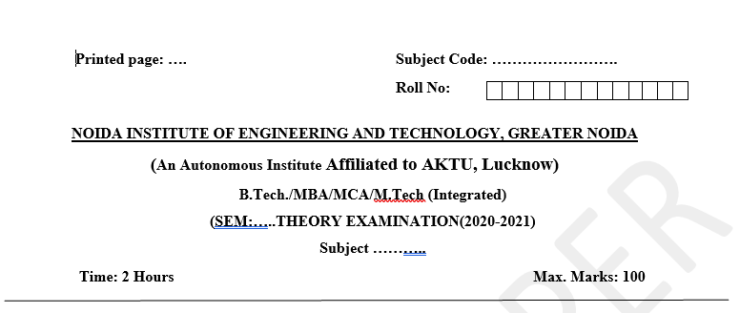
Pattern of Online External Exam Question Paper (100 marks)

Slide 16
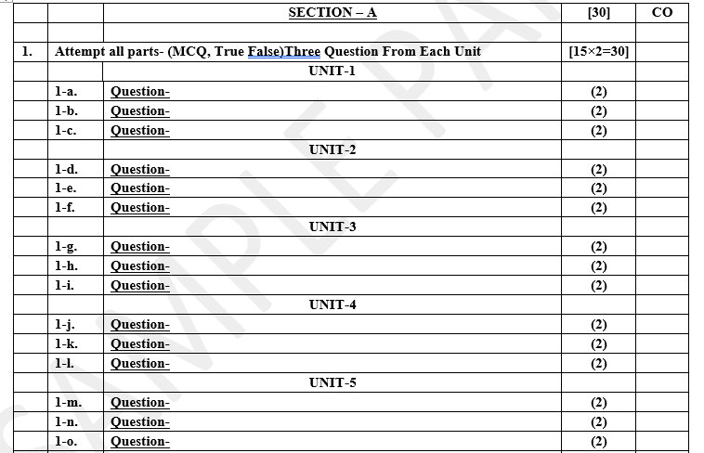
Pattern of Online External Exam Question Paper (100 marks)

Slide 17
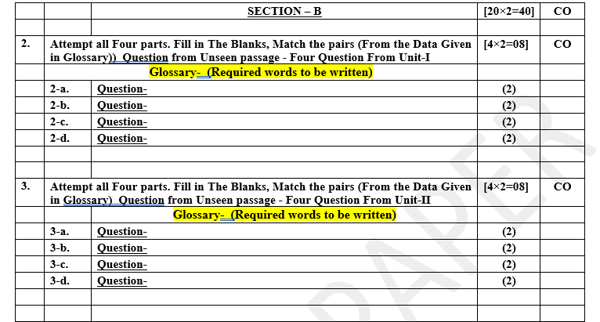
Pattern of Online External Exam Question Paper (100 marks)

Slide 18
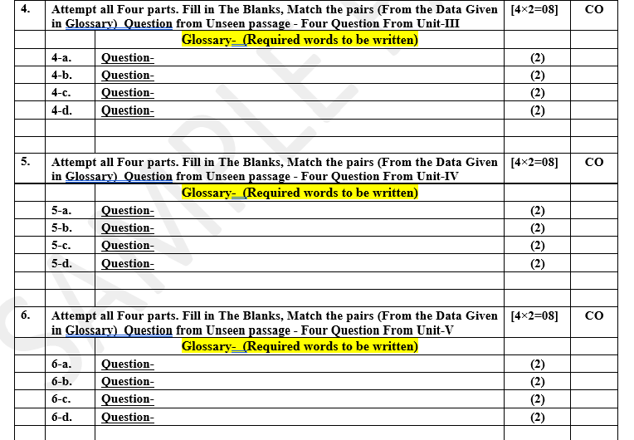
Pattern of Online External Exam Question Paper (100 marks)

Slide 19
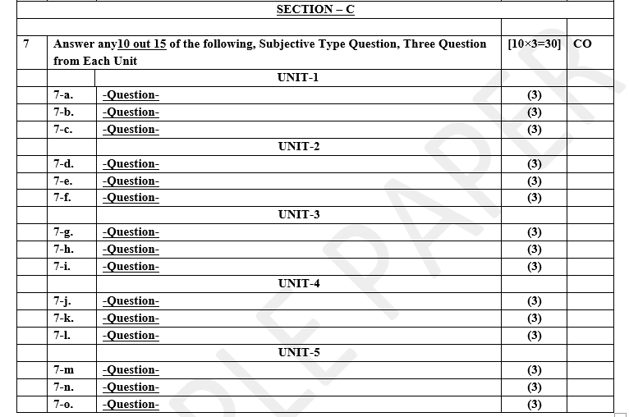
Pattern of Online External Exam Question Paper (100 marks)

Slide 20
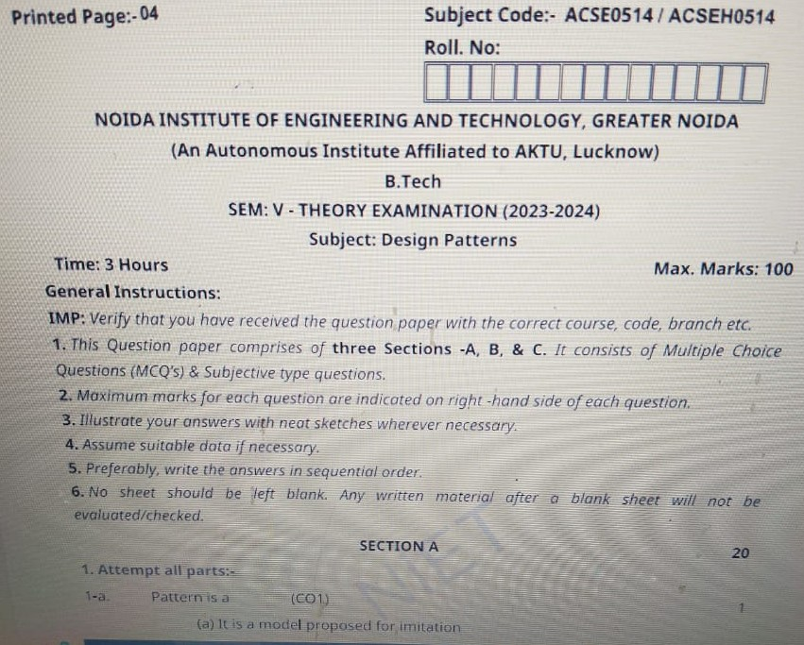
Design Pattern Previous Year Question Paper..

Slide 21
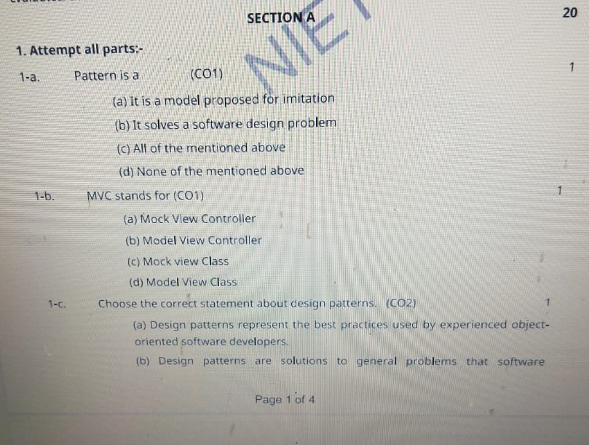
Design Pattern Previous Year Question Paper..

Slide 22
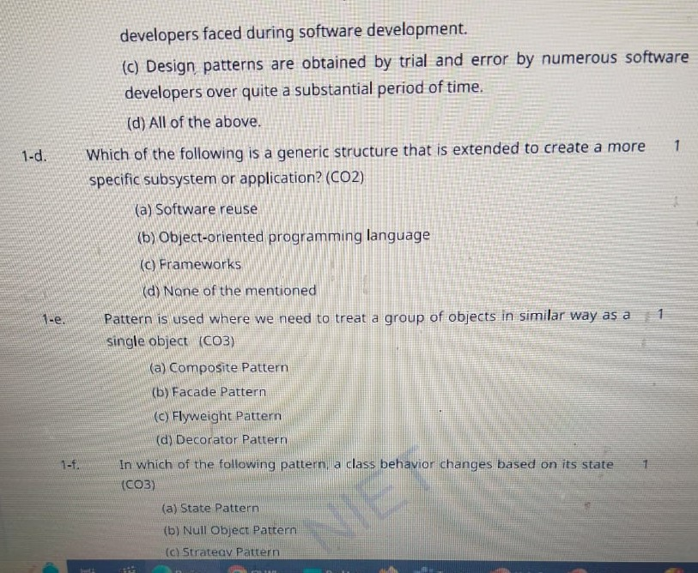
Design Pattern Previous Year Question Paper..

Slide 23
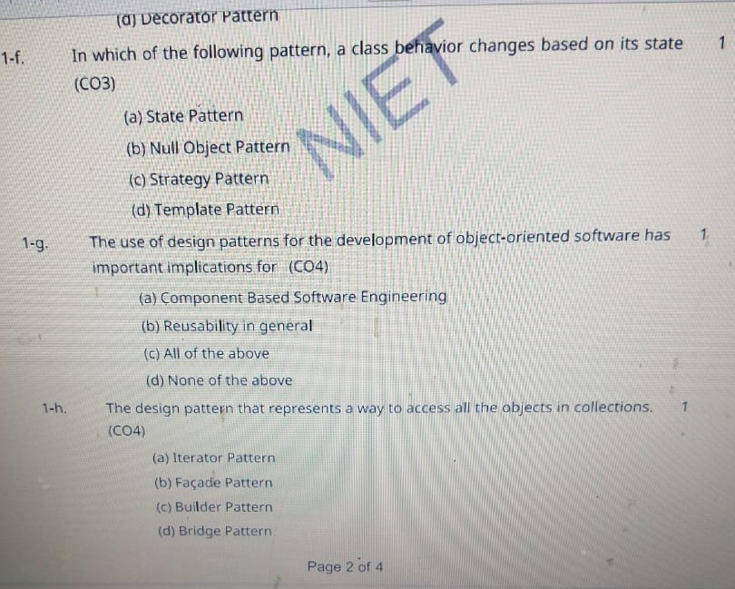
Design Pattern Previous Year Question Paper..

Slide 24
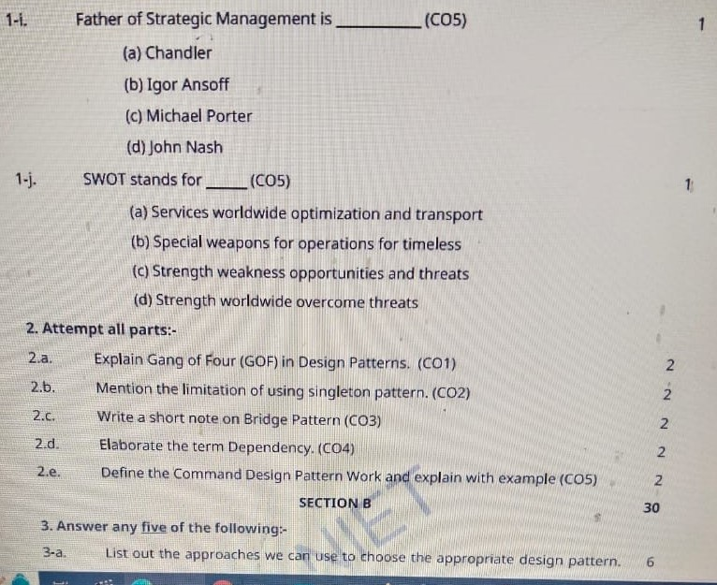
Design Pattern Previous Year Question Paper..

Slide 25
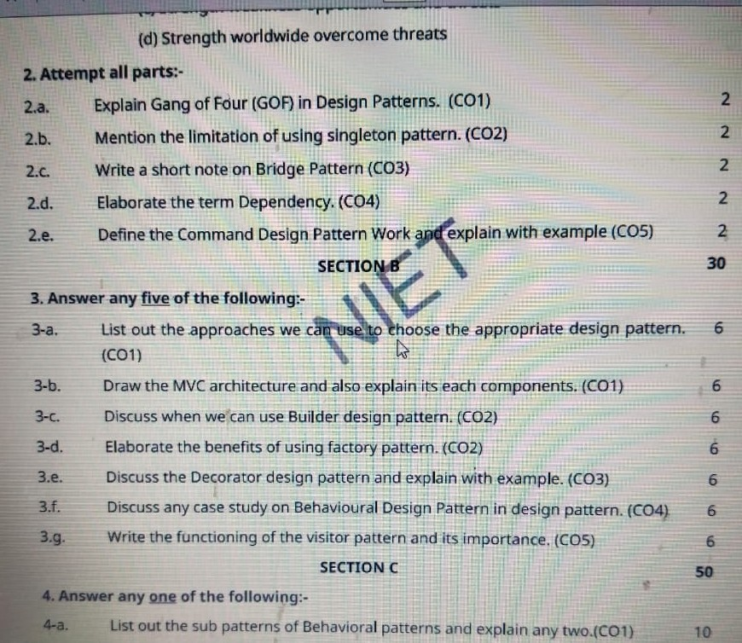
Design Pattern Previous Year Question Paper..

Slide 26
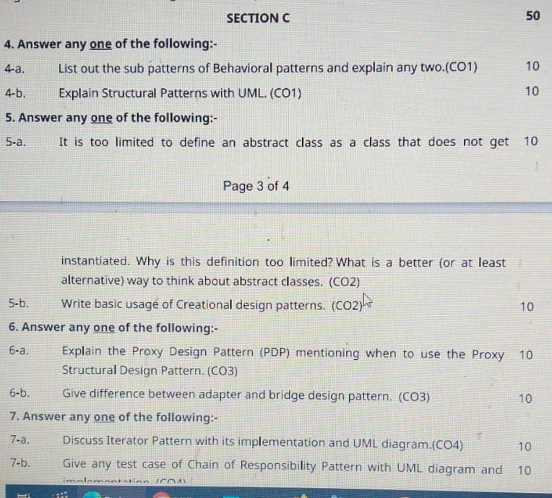
Design Pattern Previous Year Question Paper..

Slide 27
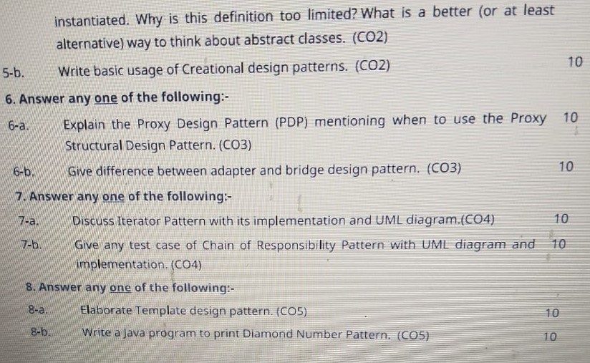
Design Pattern Previous Year Question Paper..

Slide 28
Prerequisite / Recap
Students should know object-oriented analysis and design.
Knowledge of Data structure and algorithm.
knowledge of Programming languages such as C/C++ etc.
Good problem-solving Skills.

Slide 29
Brief Introduction about the Subject with video
YouTube /other Video Links
https://youtu.be/rI4kdGLaUiQ?list=PL6n9fhu94yhUbctIoxoVTrklN3LMwTCmd
https://youtu.be/v9ejT8FO-7I?list=PLrhzvIcii6GNjpARdnO4ueTUAVR9eMBpc
https://youtu.be/VGLjQuEQgkI?list=PLt4nG7RVVk1h9lxOYSOGI9pcP3I5oblbx

Slide 30
Unit V Content
Behavioral Design Patterns Part-III :
State Pattern.
Strategy Pattern.
Template Pattern.
Visitor Pattern.
Expectation from Design Pattern.
A Case Study: Designing a Document Editor.

Slide 31
Unit V Objective
In Unit V, the students will be able to find
Definitions of terms and concepts.
The idea of a pattern.
The origins of all design patterns.
How Patterns Work in software design.
Scope of development activity: applications, toolkits, frameworks.
All Behavioral Pattern and their need.

Slide 32
Topic Objective
Topic : State Pattern.
In this topic, the students will gain , The idea of a Behavioral design pattern, In these design patterns A State Pattern says that "the class behavior changes based on its state". In State Pattern, we create objects which represent various states and a context object whose behavior varies as its state object changes.

Slide 33
State Pattern
State Pattern:-
A State Pattern says that "the class behavior changes based on its state". In State Pattern, we create objects which represent various states and a context object whose behavior varies as its state object changes.
The State Pattern is also known as Objects for States. It keeps the state-specific behaviour. It makes any state transitions explicit.
When the behavior of object depends on its state and it must be able to change its behavior at runtime according to the new state.
It is used when the operations have large, multipart conditional statements that depend on the state of an object.

Slide 34
Implementation of (State Pattern)
We are going to create a State interface defining an action and concrete state classes implementing the State interface. Context is a class which carries a State.
State Pattern Demo, our demo class, will use Context and state objects to demonstrate change in Context behavior based on type of state it is in.
In State pattern a class behavior changes based on its state. This type of design pattern comes under behavior pattern.
In State pattern, we create objects which represent various states and a context object whose behavior varies as its state object changes.

Slide 35
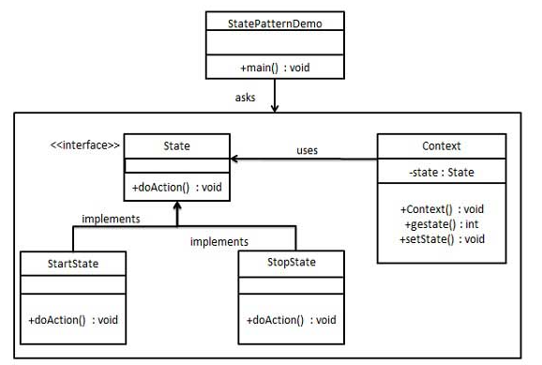
UML\Structure for State Pattern

Slide 36
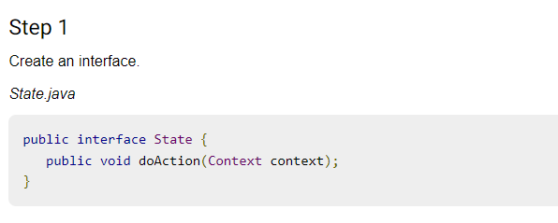
Implementation of (State Pattern)

Slide 37
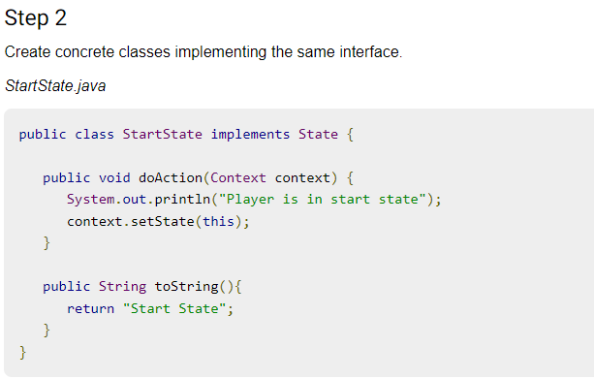
Implementation of (State Pattern)

Slide 38
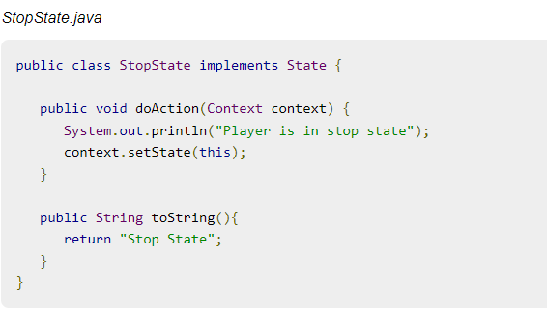
Implementation of (State Pattern)
Step -2 Cont.……..

Slide 39
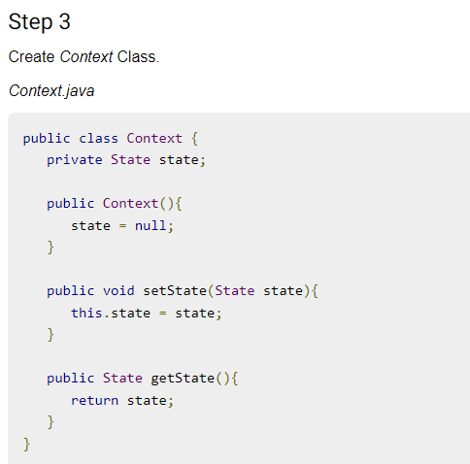
Implementation of (State Pattern)

Slide 40
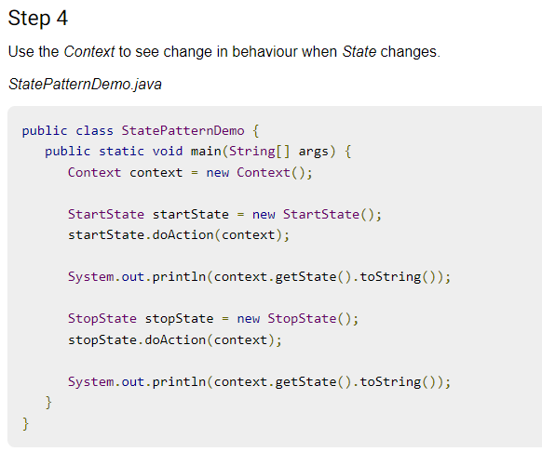
Implementation of (State Pattern)

Slide 41
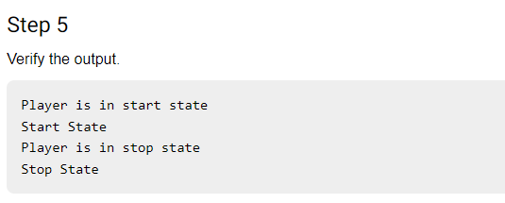
Implementation of (State Pattern)

Slide 42
Topic Objective
Topic : Strategy Pattern.
In this topic, the students will gain , The idea of a Behavioral design pattern, In these design patterns i.e Strategy pattern, a class behavior or its algorithm can be changed at run time. This type of design pattern comes under behavior pattern.

Slide 43
Strategy Pattern
Strategy Pattern:-
In Strategy pattern, we create objects which represent various strategies and a context object whose behavior varies as per its strategy object. The strategy object changes the executing algorithm of the context object.
In Strategy pattern, a class behavior or its algorithm can be changed at run time. This type of design pattern comes under behavior pattern.
A Strategy Pattern says that "defines a family of functionality, encapsulate each one, and make them interchangeable". The Strategy Pattern is also known as Policy.
It provides a substitute to sub classing.

Slide 44
Implementation of (Strategy Pattern)
We are going to create a Strategy interface defining an action and concrete strategy classes implementing the Strategy interface. Context is a class which uses a Strategy.
StrategyPatternDemo, our demo class, will use Context and strategy objects to demonstrate change in Context behaviour based on strategy it deploys or uses.
When the multiple classes differ only in their behaviors. e.g. Servlet API.It is used when you need different variations of an algorithm.
It makes it easier to extend and incorporate new behavior without changing the application.

Slide 45
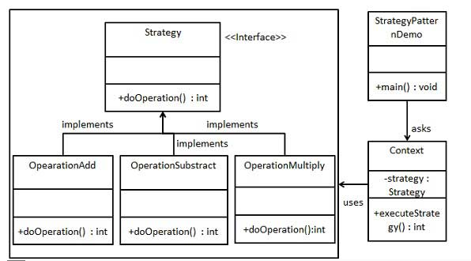
UML\Structure for Strategy Pattern

Slide 46
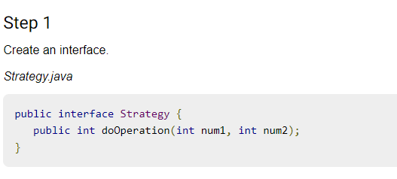
Implementation of (Strategy Pattern)

Slide 47
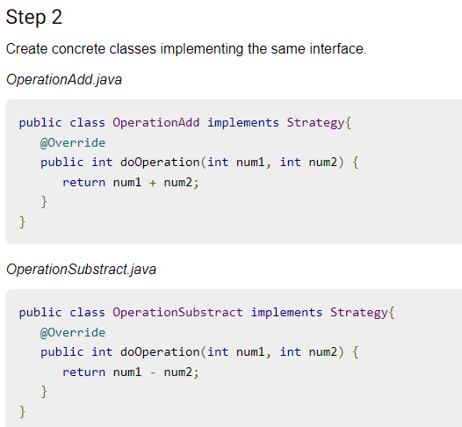
Implementation of (Strategy Pattern)

Slide 48
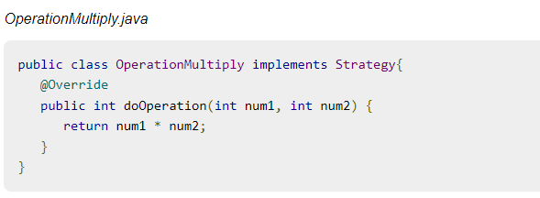
Implementation of (Strategy Pattern)
Step -2 Cont.……..

Slide 49
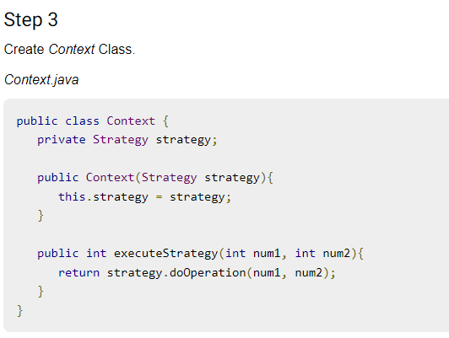
Implementation of (Strategy Pattern)

Slide 50
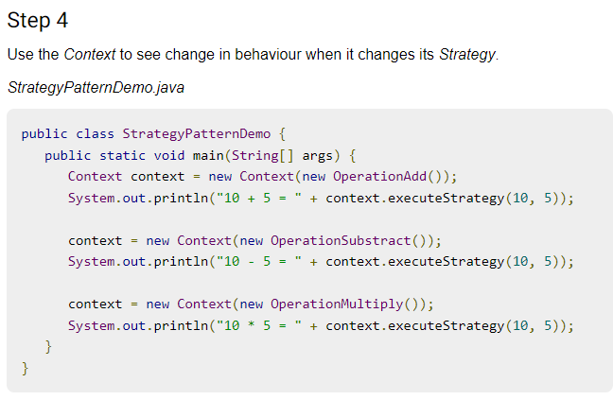
Implementation of (Strategy Pattern)

Slide 51
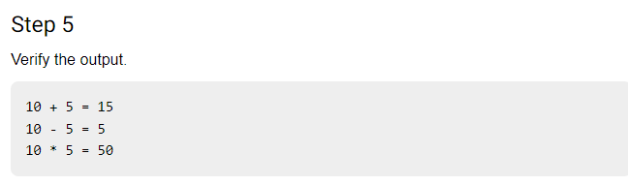
Implementation of (Strategy Pattern)

Slide 52
Topic Objective
Topic : Template Pattern.
In this topic, the students will gain , The idea of a Behavioral design pattern, In these design patterns i.e In Template pattern, an abstract class exposes defined way(s)/template(s) to execute its methods

Slide 53
Template Pattern
Template Pattern:-
In Template pattern, an abstract class exposes defined way(s)/template(s) to execute its methods. Its subclasses can override the method implementation as per need but the invocation is to be in the same way as defined by an abstract class. This pattern comes under behavior pattern category.
A Template Pattern says that "just define the skeleton of a function in an operation, deferring some steps to its subclasses".
It is used when the common behavior among sub-classes should be moved to a single common class by avoiding the duplication.

Slide 54
Implementation of (Template Pattern)
We are going to create a Game abstract class defining operations with a template method set to be final so that it cannot be overridden. Cricket and Football are concrete classes that extend Game and override its methods.
TemplatePatternDemo, our demo class, will use Game to demonstrate use of template pattern.
In Template pattern, an abstract class exposes defined way(s)/template(s) to execute its methods. Its subclasses can override the method implementation as per need but the invocation is to be in the same way as defined by an abstract class. This pattern comes under behavior pattern category.

Slide 55
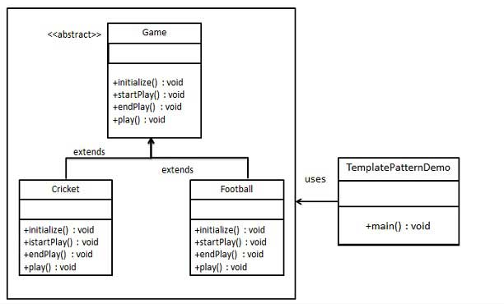
UML\Structure for Template Pattern

Slide 56
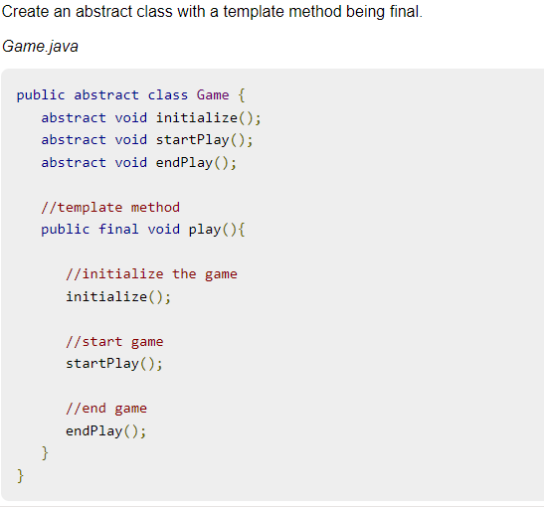

Implementation of (Template Pattern)

Slide 57
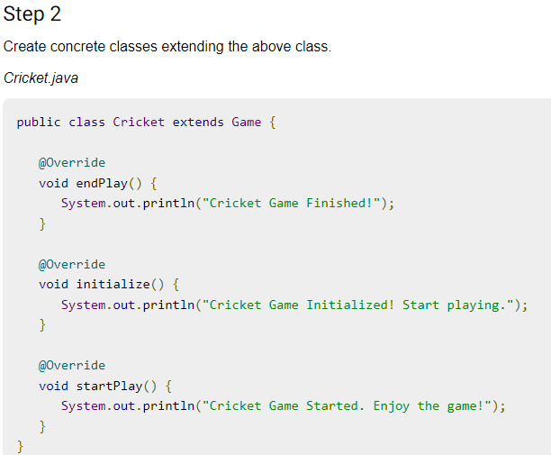
Implementation of (Template Pattern)

Slide 58
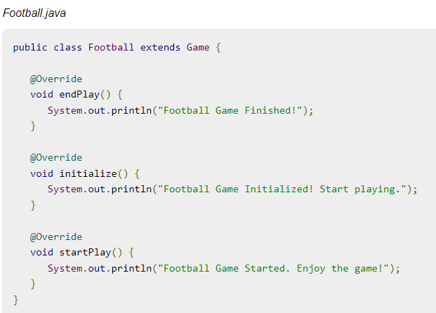
Implementation of (Template Pattern)
Step -2 Cont.……..

Slide 59
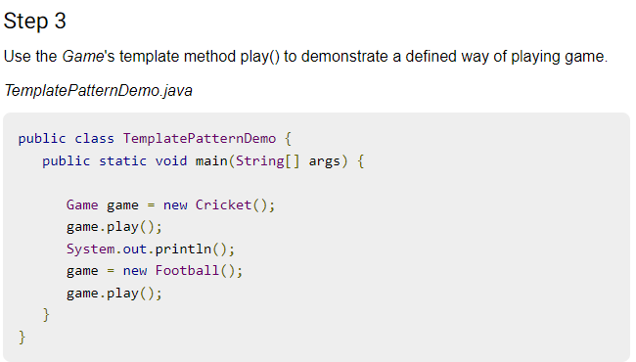
Implementation of (Template Pattern)

Slide 60
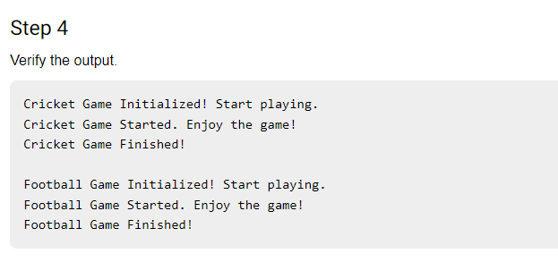
Implementation of (Template Pattern

Slide 61
Topic Objective
Topic : Visitor Pattern.
In this topic, the students will gain , The idea of a Behavioral design pattern, In these design patterns This pattern comes under behavior pattern category. As per the pattern, element object has to accept the visitor object so that visitor object handles the operation on the element object.

Slide 62
Visitor Pattern
Visitor Pattern:-
In Visitor pattern, we use a visitor class which changes the executing algorithm of an element class. By this way, execution algorithm of element can vary as and when visitor varies.
pattern comes under behavior pattern category. As per the pattern, element object has to accept the visitor object so that visitor object handles the operation on the element object.
In object-oriented programming , the visitor design pattern is a way of separating an algorithm from an object structure on which it operates. A practical result of this separation is the ability to add new operations to existing object structures without modifying the structures.

Slide 63
Implementation of (Visitor Pattern)
We are going to create a ComputerPart interface defining accept opearation.Keyboard, Mouse, Monitor and Computer are concrete classes implementing ComputerPart interface.
We will define another interface ComputerPartVisitor which will define a visitor class operations. Computer uses concrete visitor to do corresponding action.
VisitorPatternDemo, our demo class, will use Computer and ComputerPartVisitor classes to demonstrate use of visitor pattern.

Slide 64
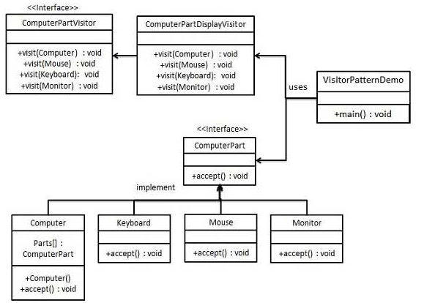
UML\Structure for Visitor Pattern

Slide 65
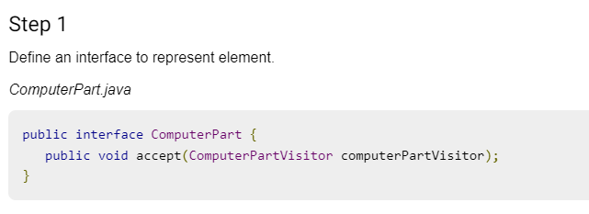
Implementation of (Visitor Pattern)

Slide 66
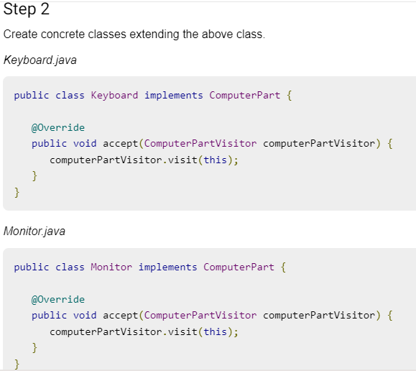
Implementation of (Visitor Pattern)

Slide 67
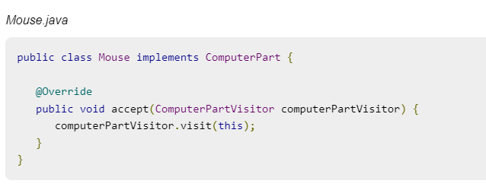
Implementation of (Visitor Pattern)
Step -2 Cont.……..

Slide 68
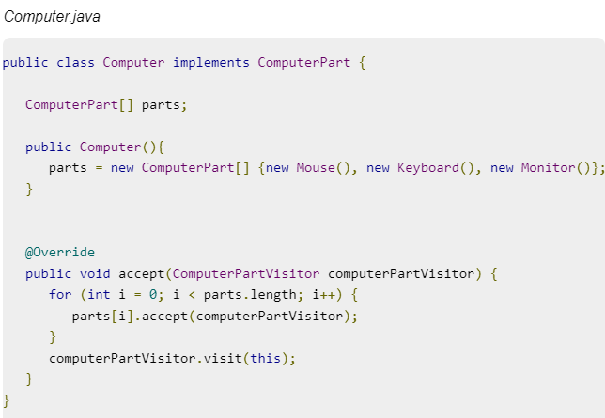
Implementation of (Visitor Pattern)
Step -2 Cont.……..

Slide 69
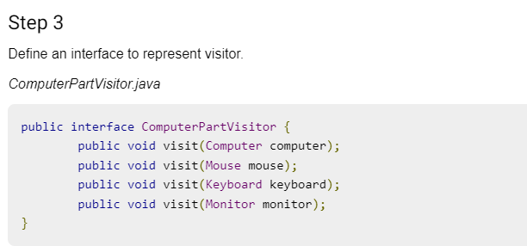
Implementation of (Visitor Pattern)

Slide 70
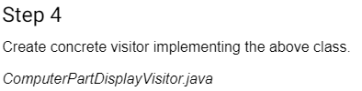
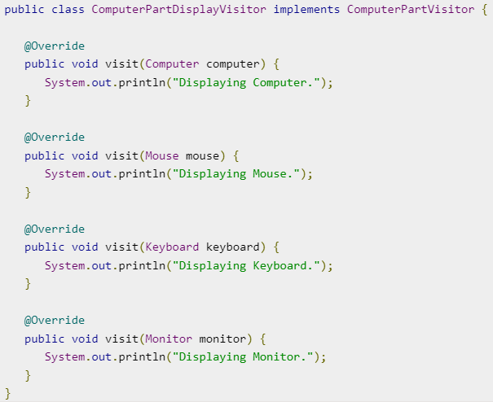
Implementation of (Visitor Pattern)

Slide 71
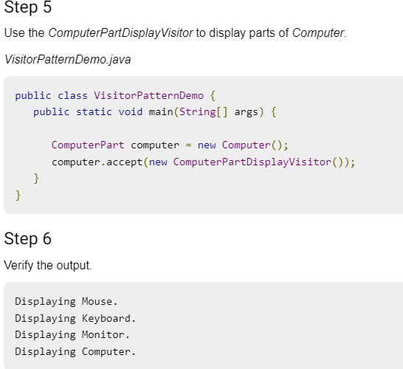
Implementation of (Visitor Pattern)

Slide 72
Topic Objective
Topic : A Case Study - Designing a Document Editor
This chapter presents a case study in the design of a “What-You-See-Is-What-You-Get” (or “WYSIWYG”) document editor called Lexi. We’ll see how design patterns capture solutions to design problems in Lexi and applications like it. By the end of this chapter you will have gained experience with eight patterns, learning them by example.

Slide 73
A Case Study - Designing a Document Editor
A WYSIWYG representation of the document occupies the large rectangular area in the center.
The document can mix text and graphics freely in a variety of formatting styles.
Surrounding the document are the usual pull-down menus and scroll bars, and a collection of page icons for jumping to a particular page in the document.

Slide 74
A Case Study - Designing a Document Editor
Design Problems
Seven problems in Lexis's design:-
Document Structure:
The choice of internal representation for the document affects nearly every aspect of Lexis's design.
All editing, formatting, displaying, and textual analysis will require traversing the representation.
The way we organize those impacts design information.
2. Formatting:
How does Lexi actually arrange text and graphics into lines and columns?
What objects are responsible for carrying out different formatting policies?
How do these policies interact with the document’s internal representation?

Slide 75
A Case Study - Designing a Document Editor
Design Problems
3. Embellishing the user interface:
Lexis user interface include scroll bar, borders and drop shadows that decorate the WYSIWYG document interface. Such trimmings are likely to change as Lexis user interface evolves.
4. Supporting multiple look-and-feel standards:
Lexi should adapt easily to different look-and-feel standards such as Modify and Presentation Manager (PM) without major modification.
5. Supporting multiple window systems:
Different look-and-feel standards are usually implemented on different window system.
Lexi’s design should be independent of the window system as possible.

Slide 76
A Case Study - Designing a Document Editor
Document Structure
An arrangement of graphical elements (characters, lines, polygon, other shapes) and structural elements (lines, columns, figures, tables, and other substructures).
Lexi's user interface should let users manipulate these substructures directly. That helps make the interface simple.
For example, a user should be able to treat a diagram as a unit rather than as a collection of individual graphical primitives.
Goals
The internal representation should support:
Maintaining the document’s physical structure.
Generating and presenting the document’s visual aspects.
Mapping positions on the display to elements in the internal representations (drawing, hit detection, alignment, etc).

Slide 77
A Case Study - Designing a Document Editor
Design Problems
User Operations:
User control Lexi through various interfaces, including buttons and pull-down menus.
The functionality beyond these interfaces is scattered throughout the objects in the application.
Spelling checking and Hyphenation (automated process of breaking words):
How does Lexi support analytical operations checking for misspelled words and determining hyphenation points?
How can we minimize the number of classes we have to modify to add a new analytical operation?

Slide 78
Daily Quiz
Which one pattern creating duplicate object?
Filter Pattern
Prototype Pattern
Bridge Pattern
Builder Pattern
Which of the following describes the Builder pattern correctly?
This pattern builds a complex object using simple objects and using a step by step approach.
This pattern refers to creating duplicate object while keeping performance in mind.
This pattern is used when creation of object directly is costly.
This pattern is used when we need to decouple an abstraction from its implementation so that the two can vary independently.

Slide 79
Daily Quiz
In which of the following pattern a class represents functionality of another class?
Proxy Pattern
Chain of Responsibility Pattern
Command Pattern
Interpreter Pattern
Which of the following describes the MVC pattern correctly?
In this pattern, a visitor class is used which changes the executing algorithm of an element class.
This pattern is used to separate application's concerns.
This pattern is used to decouple presentation tier and business tier.
This pattern is used in EJB persistence mechanism

Slide 80
Daily Quiz
The use of design patterns for the development of object-oriented software has important implications for
Component-based software engineering
Reusability in general
All of the above
None of the above
Attach additional responsibilities to an object dynamically. It provides a flexible alternative to sub classing for extending functionality.
Chain of responsibility
Adapter
Decorator
Composite

Slide 81
Weekly Assignment
Which design pattern is used to get a way to access the elements of a collection object in sequential manner?
When service locator pattern is used?
Mention in how many ways can you create singleton pattern?
Mention how one should describe a design pattern?
Explain why access to the non-static variable is not allowed from static method in Java?

Slide 82
Topic Link ( YouTube & NPTEL Video Links)
YouTube /other Video Links
https://youtu.be/rI4kdGLaUiQ?list=PL6n9fhu94yhUbctIoxoVTrklN3LMwTCmd
https://youtu.be/v9ejT8FO-7I?list=PLrhzvIcii6GNjpARdnO4ueTUAVR9eMBpc
https://youtu.be/VGLjQuEQgkI?list=PLt4nG7RVVk1h9lxOYSOGI9pcP3I5oblbx

Slide 83
MCQ
Which of the following pattern is primarily used to reduce the number of objects created and to decrease memory footprint and increase performance?
Composite Pattern
Facade Pattern
Flyweight Pattern
Decorator Pattern
In which of the following pattern, a class behavior changes based on its state?
State Pattern
Null Object Pattern
Strategy Pattern
Template Pattern

Slide 84
MCQ
3. Which design pattern provides a single class which provides simplified methods required by client and delegates call to those methods?
Adapter pattern
Builder pattern
Facade pattern
Prototype pattern
4. Which design pattern suggests multiple classes through which request is passed and multiple but only relevant classes carry out operations on the request?
Singleton pattern
Chain of responsibility pattern
State pattern
Bridge pattern

Slide 85
Glossary Questions
Top 10 design pattern interview questions
Explain Data Access Object (DAO) pattern?
Mention what is the difference between VO and JDO?
Explain the benefits of design patterns in Java.
Describe the proxy pattern.
Differentiate ordinary and abstract factory design patterns.
What do you think are the advantages of builder design patterns?
How is the bridge pattern different from the adapter pattern?
What is a command pattern?
Describe the singleton pattern along with its advantages and disadvantages.
What are anti patterns?

Slide 86
Expected Questions for University Exam
What Is Abstract Factory Pattern?
How are design patterns categorized?
Explain the benefits of design patterns in Java.
Describe the factory pattern.
Differentiate ordinary and abstract factory design patterns.
What do you think are the advantages of builder design patterns?
How is the bridge pattern different from the adapter pattern?
What is a command pattern?
Describe the singleton pattern along with its advantages and disadvantages.
What are anti patterns?

Slide 87
Summary
Till Now we understand, Behavioral design patterns are concerned with the interaction and responsibility of objects.
A State Pattern says that "the class behavior changes based on its state. i.e Strategy pattern, a class behavior or its algorithm can be changed at run time. This type of design pattern comes under behavior pattern.
The idea of a Behavioral design pattern, In these design patterns i.e In Template pattern, an abstract class exposes defined way(s)/template(s) to execute its methods.
In Visitor pattern, we use a visitor class which changes the executing algorithm of an element class. By this way, execution algorithm of element can vary as and when visitor varies.

Slide 88
References
Eric Freeman, Elisabeth Freeman, Kathy Sierra, Bert Bates Head First Design Patterns, 2004, O'Reilly.
Erich Gamma, Richard Helm, Ralph Johnson, John Vlissides Design Patterns: Elements of Reusable Object-oriented Software Addison-Wesley, 1995.
Design Pattern s By Erich Gamma , Pearson Education, 2001.
Patterns in JAVA Volume -I By Mark Grand, Wiley Dream.2002.
Patterns of Enterprise Application Architecture , Pearson Education India, 2002.

Slide 89
THANK YOU

